Slide 1
AI Generated Tabular Synthetic Data Ready for Prime Time?
AIMED Global Summit June 2023
Robert Hoyt MD FACP FAMIA ABPM-CI
David Patrishkoff MS

Slide 2
Learning Objectives
After listening to the presentation, attendees should be able to:
Enumerate the potential advantages of AI-generated tabular synthetic data (TSD)
Discuss the potential disadvantages of TSD
Compare AI-generated tabular synthetic data (TSD) with the original data
Discuss data science experiments (DSEs) to demonstrate TSD resemblance and utility

Slide 3
Disclaimers
I have no conflicts of interest to report
I will not discuss AI-generated synthetic images
We are happy to share our PowerPoint, datasets, Orange OWS files, and Excel auto-formatted spreadsheets
The results of the data science experiments (DSEs) we conducted will vary depending on the datasets, the algorithms chosen, the preprocessing steps, the hyperparameter optimization, and stochastic variation

Slide 4
Research Questions
How difficult is it to generate tabular synthetic data?
Are there accepted methods to evaluate synthetic data?
How similar is synthetic data compared to the original data?
Will rebalancing class or features with synthetic data improve model performance?
Will increasing row counts with synthetic data improve classification model discrimination and/or calibration?

Slide 5
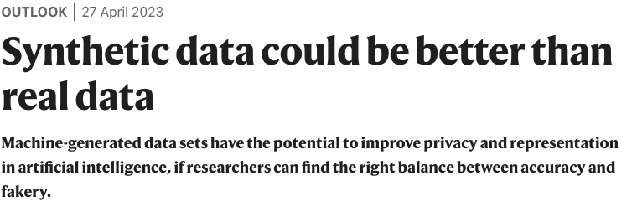
Hype or Helpful?
“Through 2030, for data used to train artificial intelligence (AI) models, synthetic tabular data will grow at least three times as fast as real structured data.” Gartner Sept 2022. https://k2view.com
UC Davis Health won a four-year, US$1.2-million grant from the US National Institutes of Health to work out ways to generate high-quality synthetic data that could help physicians to predict, diagnose and treat diseases.

Slide 6
Potential Benefits of Synthetic Data
Data quality and quantity are both lacking in most fields
Artificial intelligence, and to a lesser extent machine learning requires large datasets
In healthcare, HIPAA regulations severely limit the ability to use and share medical data with any patient identifiers
Synthetic data would make research and development with medical data much easier
It would potentially facilitate sharing clinical trial data with journals, pharmaceutical companies, and regulators without privacy concerns
There are potential cost savings if synthetic data can augment clinical trials, drug trials, etc. Also, it would reduce the cost of labeling data

Slide 7
Potential Benefits of Synthetic Data
Synthetic data may not require special disclosures or IRB approval for research, but IRBs may not be familiar with synthetic data
Synthetic data could be used to create new educational datasets of satisfactory quality and quantity
Synthetic data could augment imbalanced datasets where the target class is imbalanced
Synthetic data could potentially improve models and if it would balance features (e.g., gender, race, etc.) as well as classes. This could lead to less model bias and better prediction
Synthetic data could be valuable to study “rare” disorders
Synthetic data could be used for “innovative sandboxes”

Slide 8
Hernandez M, Epelde G, Alberdi A, Cilla R, Rankin D. Standardised Metrics and Methods for Synthetic Tabular Data Evaluation [Internet]. Available from: http://dx.doi.org/10.36227/techrxiv.16610896.v1

Slide 9
AI Generated Synthetic Tabular Data Platforms
MDClone
Gretel.ai *
Ydata.ai *
Mostly.ai *
Statice
GenRocket
Tonic ai
ClearBox.ai *
Hazy
Synthesized.io
NVIDIA LaunchPad
Nbsynthetic.data – open-source GAN
Datacebo – synthetic data vault (Python library)
* Indicates programs that I have tested

Slide 10
Software Used for Analysis of Synthetic Data
Orange – free open-source data science platform that is Python based and supported by the University of Ljubljana, Slovenia. It performs exploratory data analysis, supervised and unsupervised learning, image analytics and text mining. Customized to generate Brier Score and SMOTE. Workflow shared as an .ows file (free).
Online Kolmogorov-Smirnov (KS) Test (free)
Online Wilcoxon Rank Sum Test (free)

Slide 11
How to Evaluate Synthetic Data
Resemblance (fidelity): based largely on statistics, how closely does the synthetic data resemble the real data? QA Report
Utility: Does a prediction model using synthetic data produce similar performance (classification or regression) metrics compared to real data? Utility not reported by the vendor
Privacy: special automated checks to ensure that real patients cannot be re-identified. QA Report.

Slide 12
Resemblance: Statistical Similarity
All AI synthetic data vendors supply quality reports to show univariate and bivariate distribution and correlation matrices
In addition, there are a myriad of other statistical tests to compare real data with synthetic data. For example:
Pearson correlation
T-tests for continuous data
Information Gain (Orange = Rank widget)
Residual plots
Wilcoxon Rank Sum tests for continuous variables
Two sample Kolmogorov-Smirnov (KS) test to compare distributions

Slide 13
CORRELATIONS: MOSTLY AI HEATMAPS

Slide 14
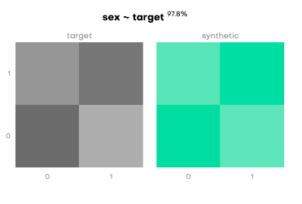
UNIVARIATE AND BIVARIATE DISTRIBUTIONS MOSTLY AI

Slide 15
Resemblance: T-tests run on Real (303) vs Synthetic Data (5000) (Heart Disease Prediction Dataset) Gretel LSTM

Slide 16
Wilcoxon Rank Sum Test for Continuous Variables. Note: The Goal is p >.05
AI

Slide 17
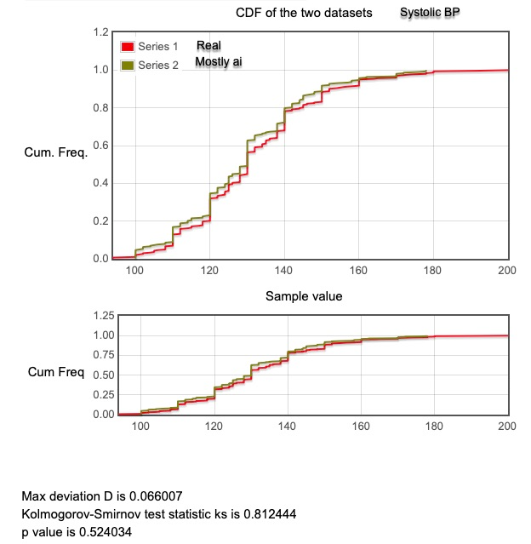
Kolmogorov-Smirnov Tests to compare distributions. Note: p-value >.05 means the distributions are very similar between real data and tabular synthetic data

Slide 18
Utility: Evaluate Classification or Regression Model Performance Metrics
Original data is split into train/test e.g., 70%/30%
Performance metrics are generated on the original data: Train on real, test on real (TRTR)
Synthetic data is cloned on the 70% training data BUT tested on the original 30% test data (hold out): Train on synthetic, test on real (TSTR)
Ideally, the synthetic model results should not be too different from the original data

Slide 19
Orange Workflow I
Split the data into 70/30 train/test and use training data to generate synthetic data. In the upper left is train and test on real (TRTR) and in the lower left train on synthetic but test on original real data (TSTR)

Slide 20
Orange Workflow II
Split the data 70/30 (train/test). Use 70% to create synthetic data.
13 algorithms used.
Obtain AUC, Recall, Specificity, Precision, Accuracy, F1, MCC and Log Loss from the Test and Score widget to calculate the sum of 8 classification metrics (S8CM):
Obtain TP, TN, FP, FN from the Confusion Matrix widget

Slide 21
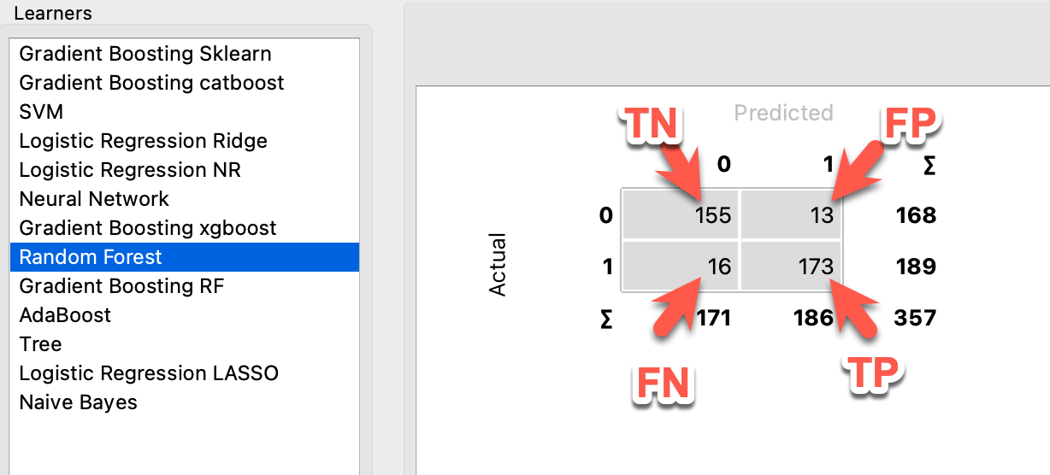
Input to Create sum of 8 classification metrics (S8CM)

Slide 22
Data Science Experiment (DSE) Excel Template: Input TP,TN,FP,FN from the Confusion Matrix widget plus AUC and Log Loss from the Test and Score widget. The results are auto-calculated and color coded. It is 1 – log loss because unlike the other results, lower is better. S8CM is the sum of the 8 metrics
Notes:
De Diego IM, Redondo AR, Fernández RR, Navarro J, Moguerza JM. General Performance Score for classification problems. Applied Intelligence. 2022 Aug 1;52(10):12049–63.
2. https://www.biorxiv.org/content/10.1101/2022.12.01.518728v1

Slide 23
Example: Best Score (5.78 catboost) on Original Data vs (6.0 xgboost) on Synthetic Data
213 Original Subjects
50k Synthetic Subjects
Orange Algorithm | S8CM
Extreme Gradient Boosting - xgboost | 5.383
Random Forest | 5.755
Gradient Boosting - scikit learn | 3.768
Gradient Boosting - catboost | 5.784
Adaboost | -2.334
Tree | 1.079
Extreme Gradient Boosting RF - xgboost | 5.157
SVM | 5.703
Logistic regression Ridge | 5.723
Logistic regression no regularization | 5.514
Logistic regression Lasso | 5.708
Neural Network | #DIV/0!
Naïve Bayes | 5.605
Orange Algorithm | S8CM
Extreme Gradient Boosting - xgboost | 6.007
Random Forest | 5.984
Gradient Boosting - scikit learn | 5.683
Gradient Boosting - catboost | 5.562
Adaboost | -5.632
Tree | -1.383
Extreme Gradient Boosting RF - xgboost | 5.717
SVM | 5.464
Logistic regression Ridge | 5.577
Logistic regression no regularization | 5.576
Logistic regression Lasso | 5.574
Neural Network | 5.644
Naïve Bayes | 5.853
Best
Best
(Recall = 0)

Slide 24
Privacy
There are three common methods to judge privacy on TSD
Identical match share (IMS): are there exact copies?
Distance to closest record (DCR): distance measure to prove synthetic samples are not identical to original data
Nearest Neighbor distance ratio (NNDR): uses k-nearest neighbor ratios on the synthetic data overlapped with the original data
No easy method to confirm privacy

Slide 25
Data Science Experiments
Real vs Tabular Synthetic data (TSD)
Gretel LSTM vs Gretel GAN – resemblance and utility
Gretel LSTM vs Gretel GAN vs MOSTLY AI vs YData
Data Rebalancing with TSD
Class rebalancing
Feature rebalancing
Augmenting Data with TSD
For education and research
Determine optimal sample size

Slide 26
Real vs TSD
We used Gretel AI first and we wrongly assumed that GANs would outperform other AI methods
This caused us to first compare Gretel LSTM results with Gretel GANs
As it turns out, LSTMs outperformed GANs for both resemblance and utility (classification and regression)
Next slide shows results on TRTR and TSTR on a heart disease dataset of 303 subjects divided into 213 train and 90 test using four AI methods

Slide 27
Results: Utility is highest on Real Data When Size is the Same
Dataset | Size | Best Algorithm | S8CM
Real Data | 213 | Random Forest | 5.78
MOSTLY AI | 213 | SVM | 5.66
Gretel LSTM | 213 | Catboost | 5.57
Gretel GAN | 213 | Logistic Regression (ridge) | 4.58
YData | 213 | Logistic Regression (ridge) | 4.58

Slide 28
Class Rebalancing with MOSTLY AI
Framingham heart dataset: predict ten-year CHD. 644 developed CHD and 3596 did not, or a 15%/85% ratio
Synthetic data was generated on the training data (2968) and tested on the held-out test data (1272) (70/30 split). A new option for MOSTLY AI (March 2023) was to rebalance the target to 50%/50%. The rebalancing method was not disclosed. The total number of subjects remained the same.
We also compared model discrimination using synthetic rebalancing with threshold shifting, algorithmic weighting, and SMOTE
We also analyzed a stroke dataset with 5% strokes. Train on 3577 and test on 1533 (70/30 split). The class was rebalanced 50%/50% with MOSTLY AI

Slide 29
Results: Decreased S8CM Scores
Dataset | Size | Algorithm | S8CM
Imbalanced Heart | 2968/1272 | Logistic Regression (Ridge) | 4.334
Balanced Synthetic Heart | 2968/ 1272 | Logistic Regression (LASSO) | 3.550
Imbalanced Stroke | 3577/1533 | Naïve Bayes | 4.43
Balanced Synthetic Stroke | 3577/1533 | Logistic Regression LASSO | 4.087
The results for threshold shifting, weighting of logistic regression and random forest and SMOTE were very similar to synthetic rebalancing.
Sensitivity (recall) improved but there was low precision (PPV)
MCC improved for both models
In general, AUC, accuracy, and specificity fell slightly.

Slide 30
REBALANCING AND MODEL CALIBRATION
Model discrimination is important but too often model calibration is forgotten. Model discrimination is usually reported as AUC. Model calibration is reported as a Brier Score and/or a calibration plot.
Brier Score: Measures the accuracy of predicted probabilities. Zero is perfect accuracy to suggest predicted probabilities = actual results.
What happens to calibration when you rebalance?
The answer was that for this dataset and the algorithms used, calibration worsened for synthetic data and weighting but stayed about the same for threshold shifting and SMOTE, compared to baseline, based on calibration plots and Brier Scores.
Results next slide

Slide 31
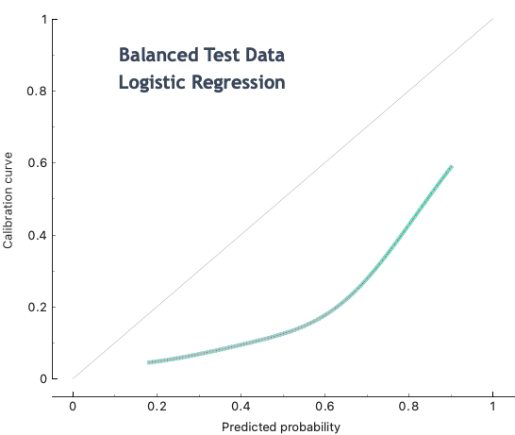
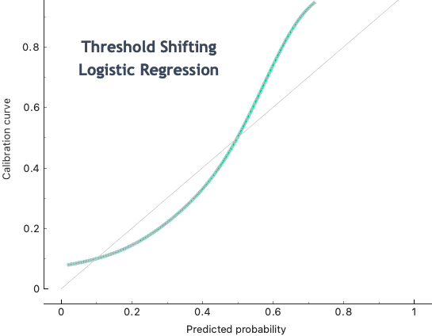
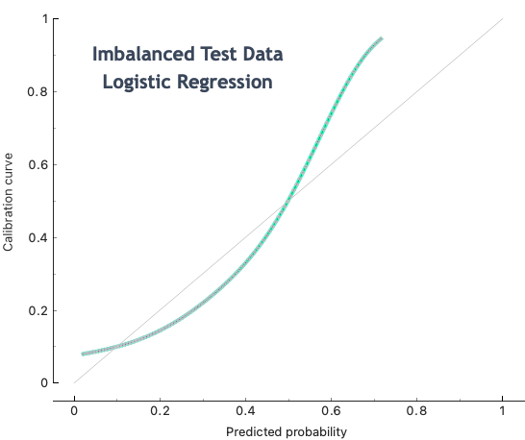
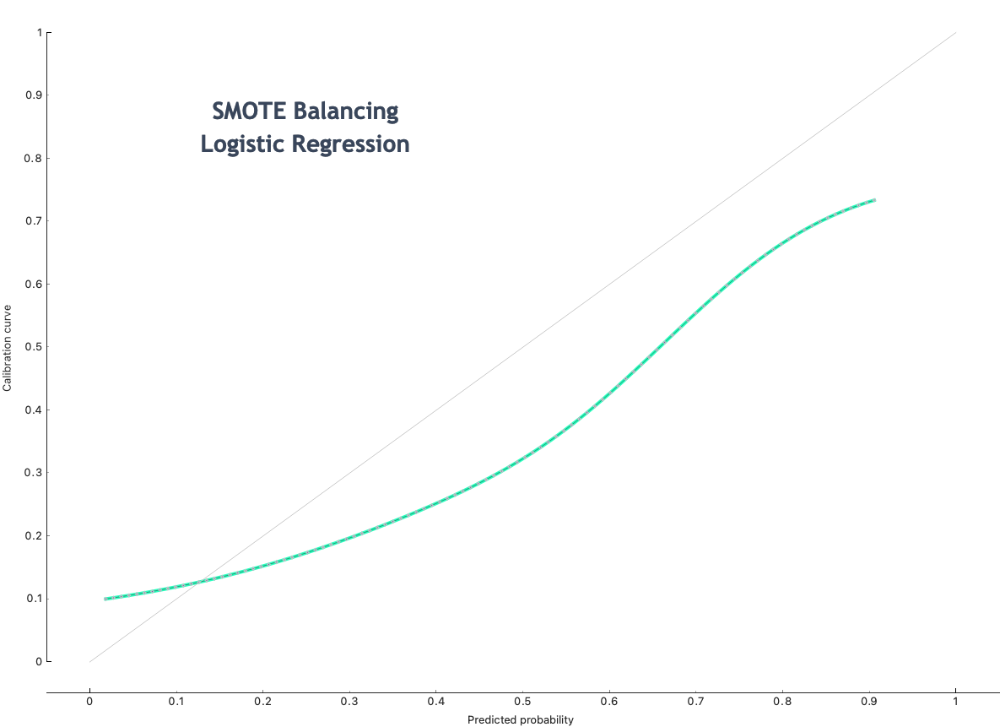
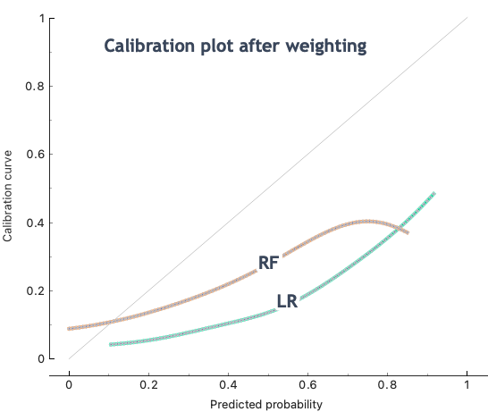
Calibration Results
Data | Brier Score
Imbalanced | 0.034
Balanced with MOSTLY AI | 0.175
Threshold shifting | 0.228
Algorithm weighting | 0.450
SMOTE | 0.033

Slide 32
Augmenting Sample Size for Education and Research
The steps to accomplish this are quite easy in Gretel and MOSTLY AI
Upload the data, determine the number to be synthetized and any modification such as balancing. Time = 1-3 minutes.
The Cleveland Clinic Heart Disease Dataset consists of 303 patients with 13 predictors. It is frequently used for classification of heart disease/no heart disease
Using Gretel LSTM, we created a synthetic dataset of 5000 patients that would be more robust for machine learning and AI that was based on the real dataset of 303 subjects

Slide 33
What is My Personal Interest in TSD and Why?
To teach data science you should have adequate data quality and quantity for your domain
85% of all clinical trials fail to recruit enough patients, and 80% are delayed due to recruitment problems. Meanwhile, dropout rates are consistently high so patient numbers are often less than ideal
Standard data repositories have datasets that tend to be old and small – for example, the University of California Irvine ML Repository
UCI ML Repository has released a new beta version that has a few newer datasets. The size and date of datasets – next slide
Notes:
https://healthmatch.io/clinical-trials/understanding-patient-retention-in-clinical-trials

Slide 34
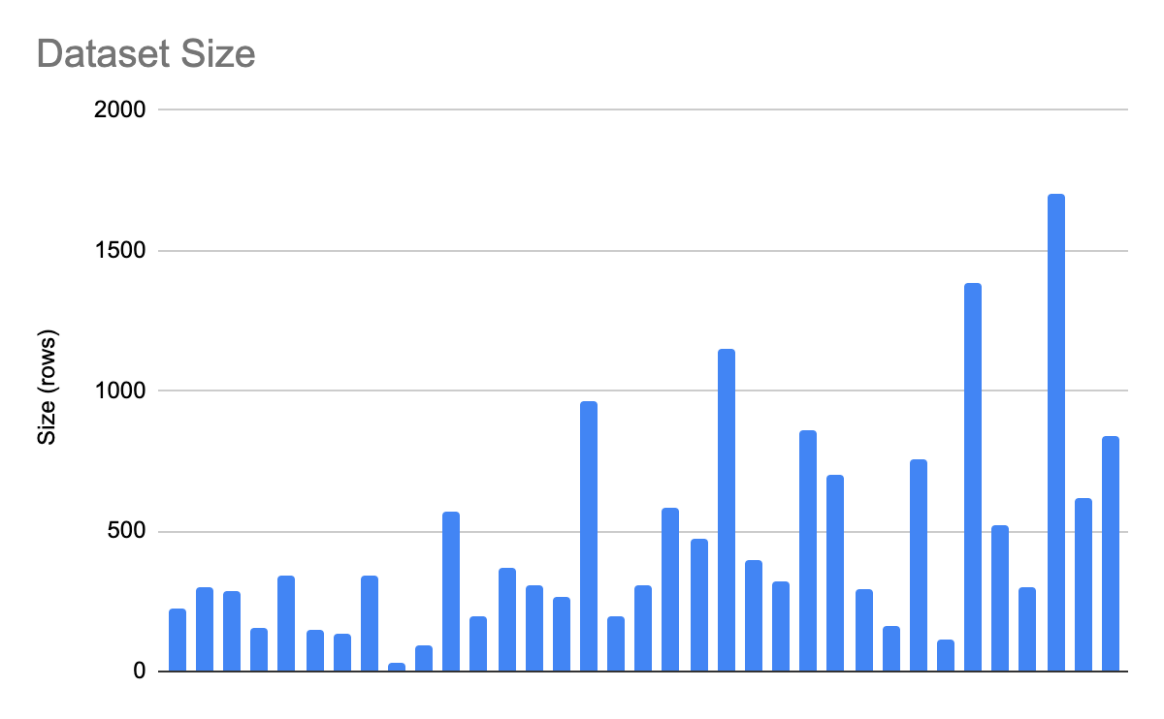
Current UCI Datasets: 36 are medical out of total of 626 (6%). Most are small and old. Generate and Donate!

Slide 35
Would Further Increase in Synthetic Data Improve Model Performance?
We found that classification model performance is always better on the TRTR than the TSTR with the same training and test size but what would happen if the training data size was greatly increased?
Using three different datasets we generated 50,000-100,000 synthetic subjects using MOSTLY AI and compared the classification model performance with the original dataset performance
We compared TRTR with TSTR using 13 algorithms and measuring performance based on S8CM
Results on next slide
In only one DSE did the performance improve by increasing the dataset size

Slide 36
Augmented Datasets with MOSTLY AI and Resulting Performance
Dataset | Size | Algorithm | S8CM
Heart | 213 50K | Catboost Xgboost | 5.78 6.00
Combined Heart | 833 50K 100K | Xgboost Catboost Xgboost | 6.75 6.09 6.18
Coimbra Breast Cancer | 58 50K | SVM Logistic regression Ridge | 4.78 4.24
Body Fat Regression | 177 50K | Linear Regression Gradient Boosting | RMSE =4.56 R² = 0.705 RMSE = 6.23 R² = 0.499

Slide 37
Issues Related to AI Tabular Synthetic Data
TSD performance is better with larger datasets
AI-generated TSD will not create a longitudinal dataset
Not all vendors reveal their methodologies
While synthetic data might reduce bias, it potentially could introduce new biases
How will IRBs and others respond to the request to create synthetic data from real medical data?

Slide 38
Real World TSD Challenge
Duke has a shareable data repository SOAR
We downloaded their cardiac cath dataset (DukeCathR) which was intended for educational purposes only, on May 5, 2023
Despite the dataset being permutated they did not want the data published or shared. Faculty/students must sign a DUA, it must be used on an LMS, and data must be destroyed after use
We asked about cloning the dataset and then sharing
Clearly, this was a highly unusual request and one they have not approved at this point
Also, we contacted two university IRBs, and they did not have a synthetic data policy in place

Slide 39
HIPAA Privacy Rule and Synthetic Data

Slide 40
Conclusions
TSD generation is a relatively new benefit of AI
TSD may be useful for educational or software developmental purposes
TSD Resemblance and Privacy are good
TSD Utility is better with larger datasets creating a Catch-22 scenario – you need enough data to create more data
Utility remains a challenge as only one model we created using the TRTR/TSTR strategies performed better with more synthetic data. There is no guarantee that augmented or rebalanced classes or features will improve model performance
Unclear how GDPR/HIPAA and IRBs will approach AI-generated TSD
More research is needed with more data and more vendors
I encourage participants to create and test their own synthetic data

Slide 41
Questions?
rehoyt@gmail.com
https://www.nocodedatascience.net
Data Science Experiment Excel Spreadsheet (File-Share tab) https://www.nocodedatascience.net/file-share

